Slide 1

SMART INDIA HACKATHON 2024
TITLE PAGE
Problem Statement ID – SIH1658
Problem Statement Title- Development of a versatile and fast algorithm for the optimal ship routing
Theme- Transportation and Logistics
PS Category- Software
Team ID - 28349
Team Name – Human Cyborgs
PROPOSED SOLUTION
We have developed a Deep Learning Model which has less Time Complexity
This Model takes real time data through API for weather
The Web-app consumes a very less space complexity of only 2 GB.
It’s a fast running DL model with ease access to people with zero knowledge of Machine Learning
It shows the optimal route depending on the type of cargo too
Depending on the type of cargo, vessel type and distance it displays the fuel requirement
It displays the coordinates of the route to be followed in case of navigation compass failure

Slide 2
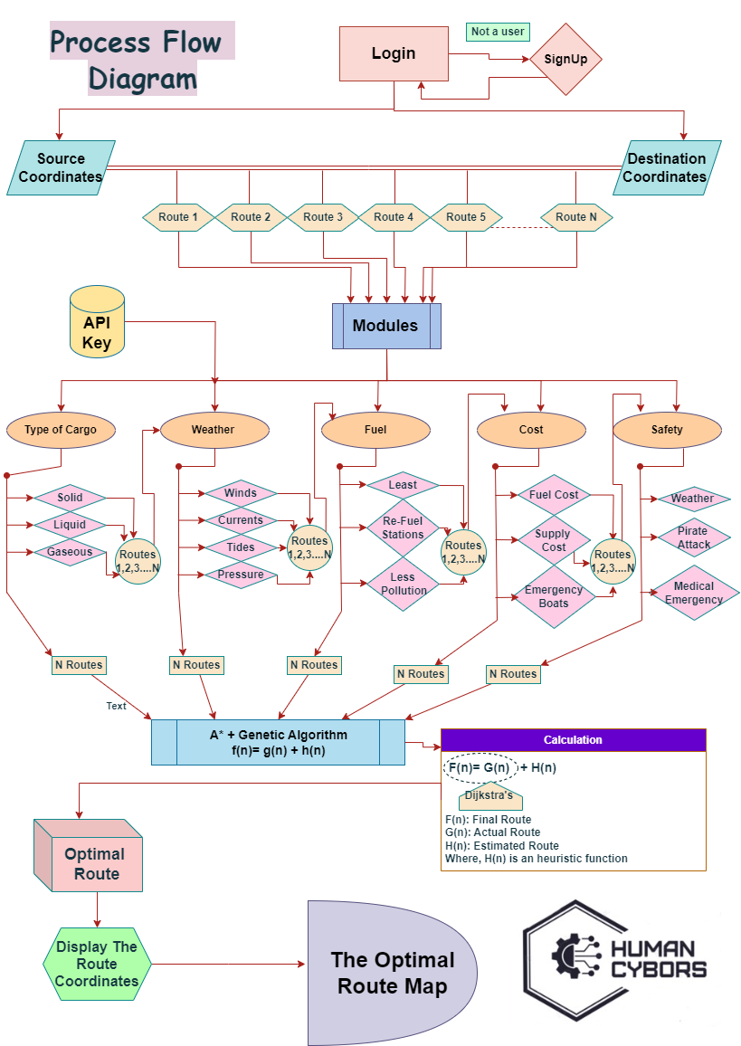

SRO(Ship Route Optimizer)
Database
OBJECTIVES
Developing a Model which provides a Low fuel Consumption route
Follow a Zero Carbon Emission Policy
Main Priority is to provide Comfort & Safety to passengers and crew members
To provide a solution to the shipping industry which is Sustainable & supports Green Technology
Access & Implement the evolving weather changes
Making the travel time least by analyzing the factors like weather, fuel etc.
Designing an algorithm which is accessible to the public with less time complexity and ease of access.
Ensuring the route in such a way that it provides No Vessel Damage moto.
ADDITIONAL FEATURES
An external feature is added in case of no network a simple Map color reader is embedded in the algorithm, which will give the result just by reading colors of them MAP
As its difficult to check software internal calculations manually we have an embedded feature which shows the Results of the Internal Algorithmic Calculation.
AI Assistance, we have added a ChatBot for navigating through the webapp
Identifies Ship Traffic in nearby regions

Slide 3

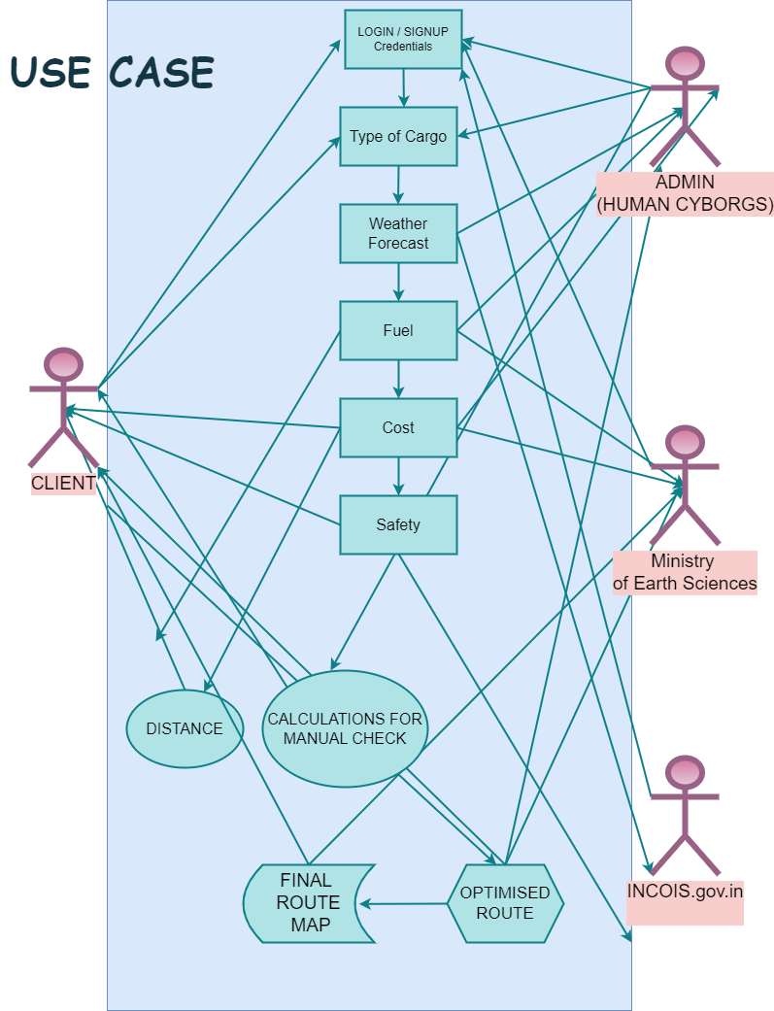
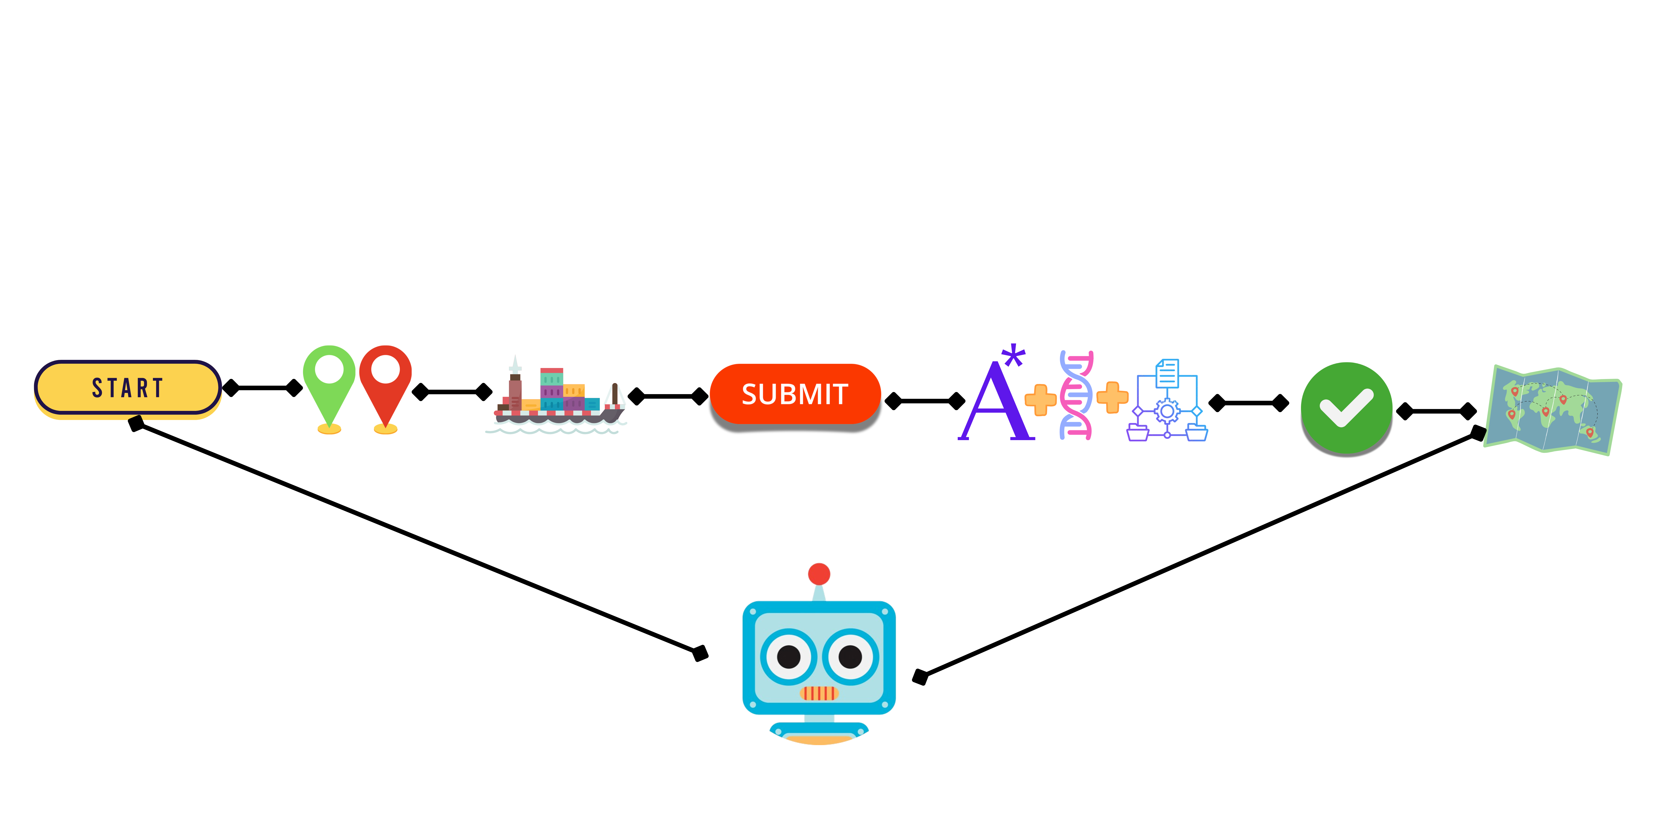










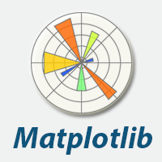




TECHNICAL APPROACH
Technology Stack
Simple Demonstration of working of the Model
1) Enter Source & Destination Coordinates
3) Submit the details
2) Enter the type of Cargo or select Passengers
4) Machine Learning algorithms A8, Genetic & Dijkstra’s are implemented
ANCHOR
5) The coordinates of the Route are provided
6) The Map of the Optimal Route is Displayed
For any assistance we have provided a ChatBot
Stakeholders

Slide 4
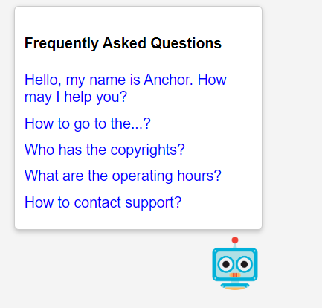
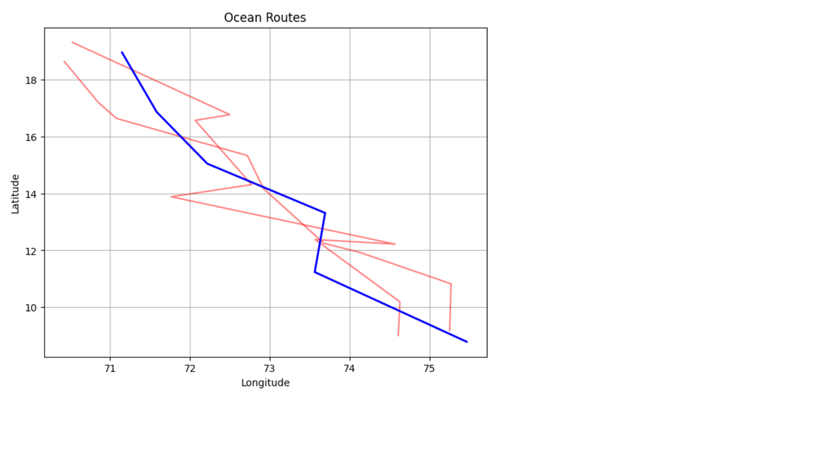
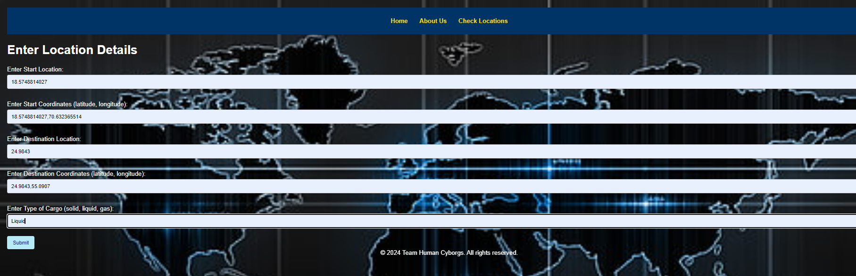
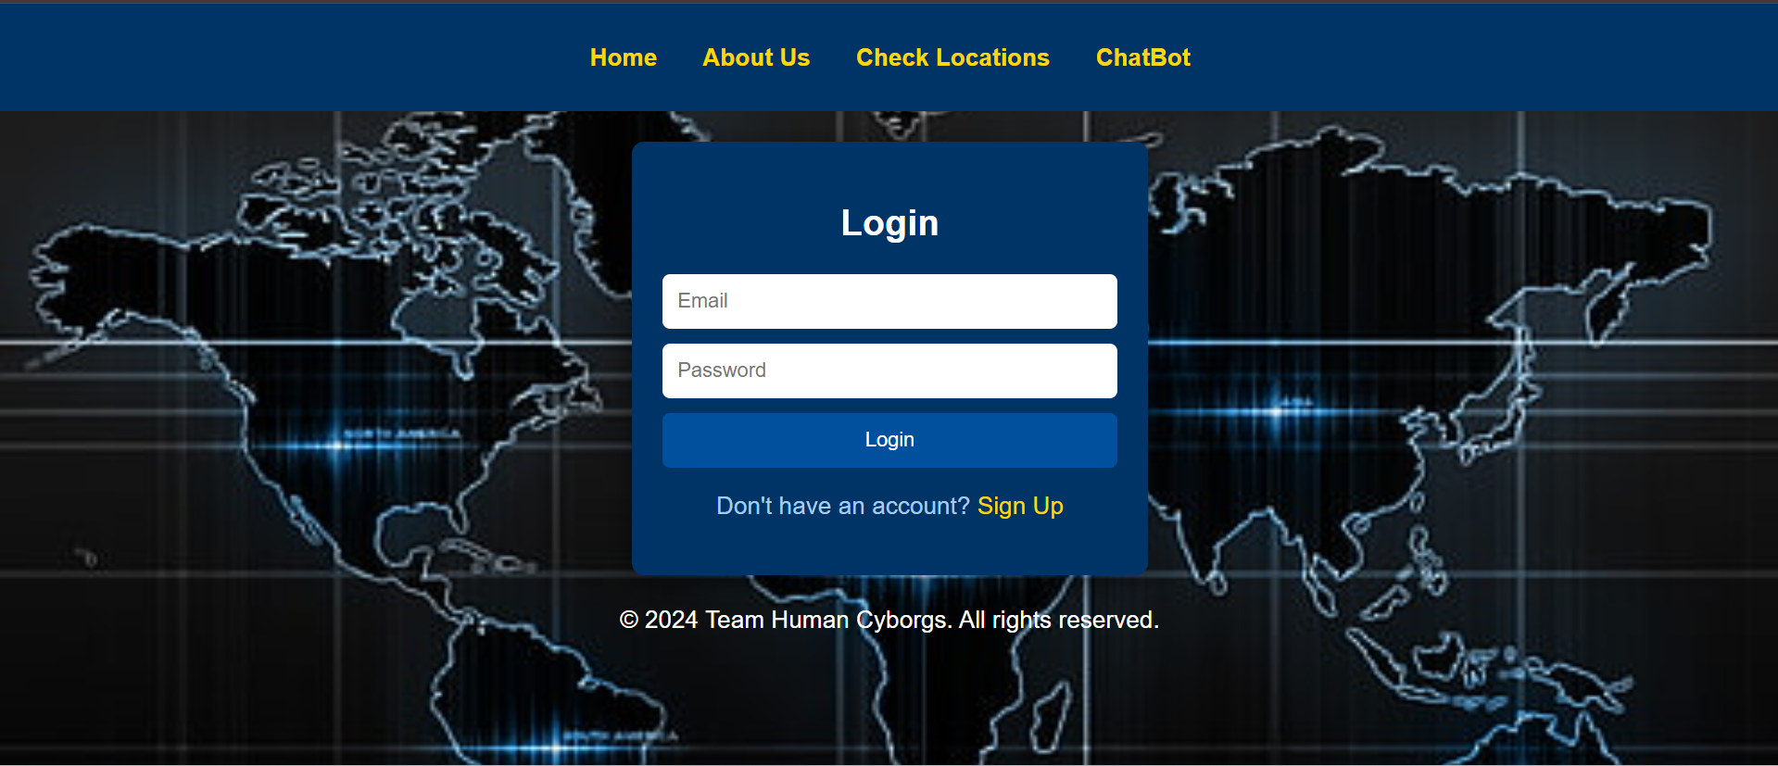
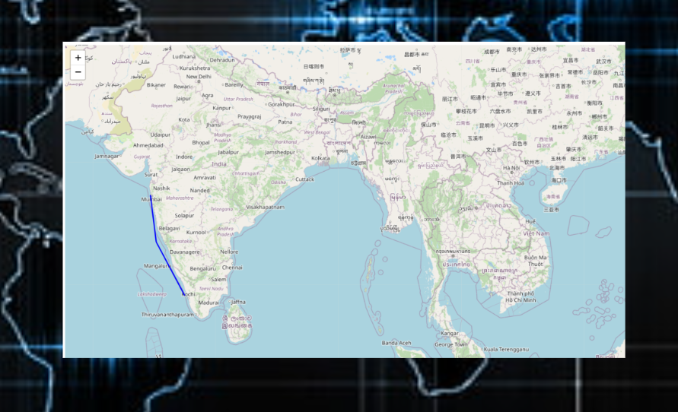
FEASIBILITY AND VIABILITY
Feasibility Analysis:
Technical Feasibility: Takes up low RAM space
Financial Feasibility: It’s a simple Webapp using API thus, no much costing
Market Value: The product being developed at low cost and the requirement being more than 90% has a huge market scale.
The USP of our product makes it stand & Sustain in the market for long
Strategies for Overcoming Challenges:
To overcome the problem of data availability regarding weather we can add another API of renowned weather forecasting institutions
The Network problem is already resolved with the help of MAP Color Reader and we plan to add one more such feature too.
As soon as we get Google Earth API accessing the coordinates would be much easier, though we have already added a link to find the current coordinates of the user
Database is easily expandable, old data is auto deleted after a certain time period creating more space.
PROTOTYPE
Potential Challenges and Risks:
Data Availability: The evolving weather data should be available easily for further proceedings
Network/ Internet: If a problem occurs regarding the signal then a risk occurs
Google Earth API: At present we don’t have a system which tracks the location of the client but, if we get more support through the Ministry we can acquire the real time data through Google Cloud for developers
Increasing Database: As the database will be increasing we’ll require a good backend system for ensuring safe & prompt storage of client data

Slide 5
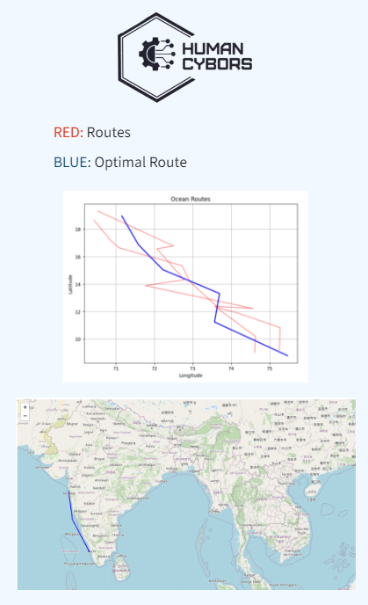
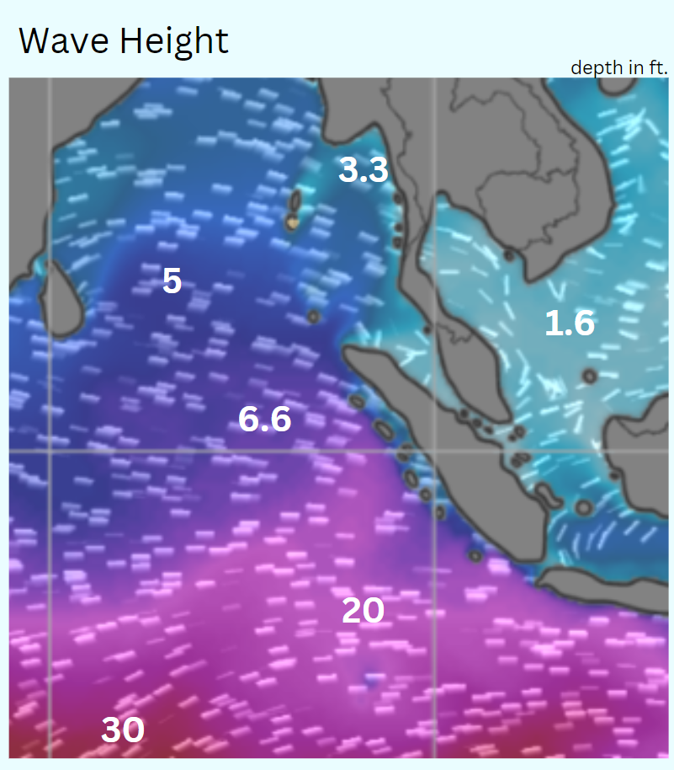
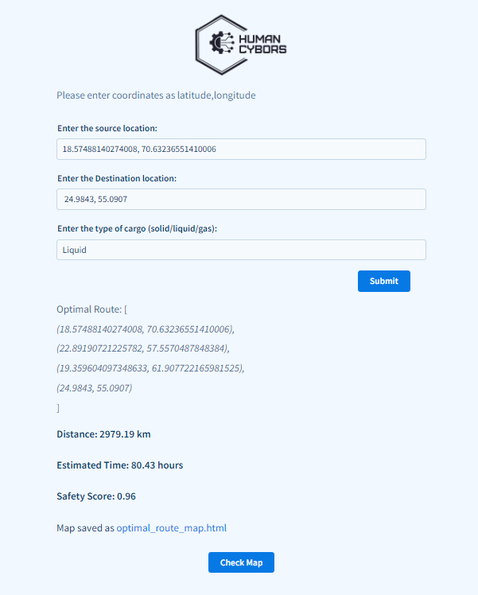
IMPACT AND BENEFITS
Our USP:
Space complexity of only 2 GB
Zero carbon emission policy
Internal Algorithmic Calculation for manual checks which NAVTOR lacks
Map Colour Reader which helps in emergencies or turbulence
Ease of access to local public(e.g.- Fishermen )
Low Cost software
Graphical Representation of coordinates
Ship Traffic in nearby Locations
Potential Impact:
Shipping Industry: The whole shipping industry relies on Navigation systems, thus this software will definitely create a huge impact for their traversals
Regulatory Functioning Bodies: The Fishermen, Sailors will have a great solution for deciding their travel routes
Port In charges: The Port authorities can use this for avoid ocean traffic
Client: The client being our biggest buyer, will help them to easily navigate through the vast ocean & seas
Environmental: The Environment preserving agencies will have a huge impact because of the zero carbon emission policy
**Our Project is built in such a way that in case of any challenges occur the Team Human Cyborgs can easily identify, resolve and provide a versatile solution to it, thus ensuring assurance and honesty towards the Client
Benefits of the Proposed Solution:
Less Reliability on anyone for deciding navigational path
Socially made for good cause for safety of human kind
Financially at low risk as it stands in a never ending market
Technically at ease due to simple implementation while performing a complex task
Environment friendly approach makes our solution a big hit
Transparency of the webapp ensures smooth usage for the sailor

Slide 6
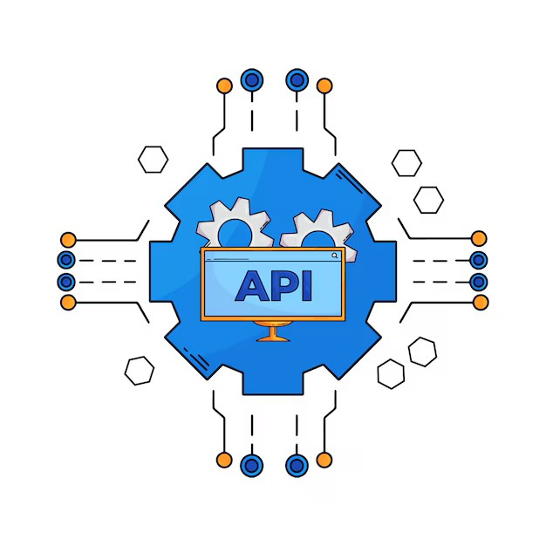
RESEARCH AND REFERENCES
RESEARCH PAPER JOURNAL | NAME OF THE PAPER | NAME OF THE AUTHOR
IEEE Explore | Ship weather routing based on grid system and modified genetic algorithm | Peng Zhou; Hongbo Wang; Zhiying Guan
IEEE Explore | Research on Ship Weather Routing Method Based on Dijkstra Algorithm and Neural Network | Khanh Doan Huu
ELSEVIER | A comprehensive ship weather routing system using CMEMS products and A* algorithm | Manel Grifoll , Clara Bor´en, Marcella Castells-Sanabra
Research Gate | The Ship-Routing Optimization Based on the Three-Dimensional Modified Isochrone Method | Yu-Hsien Lin
References:
Real Time App:
NAVTOR
Polaris
Took real time problems faced data from Merchant Navy Captain
CONCLUSION: In conclusion, we propose that we meet the requirements of the client and always ready to provide extra features and services to serve the client fully.

